Slide 1
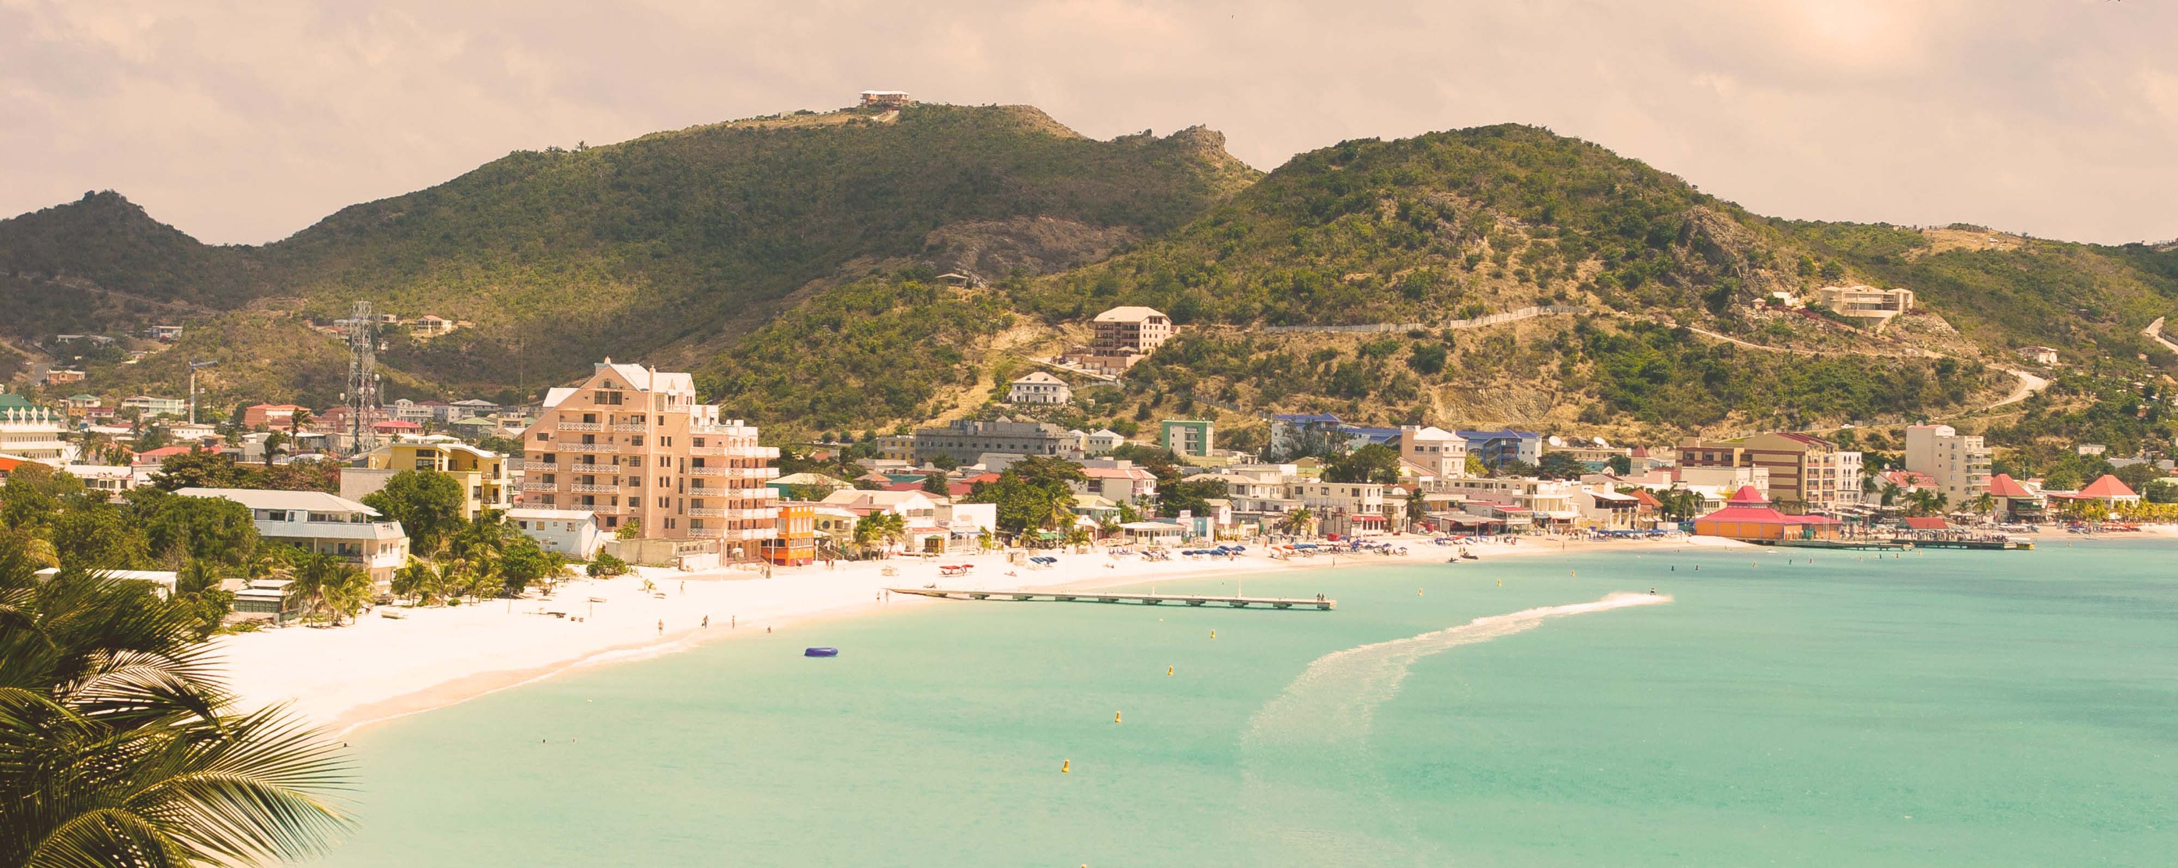




Eastern Caribbean & Bimini Beach Club
Miami • Philipsburg • Tortola • St. Croix • San Juan • Puerto Plata • The Beach Club at Bimini • Miami
1 night in Miami + 10 nights sailing
Departing 10 January 2027
All flights included
Sea View Lock It In Rate
Sea Terrace Lock It In Rate from £1882pp
£1659pp
£60pp in resort fees payable locally. Subject to change. View terms here: sellvv.co.uk/terms
Insert your
logo here

Slide 2
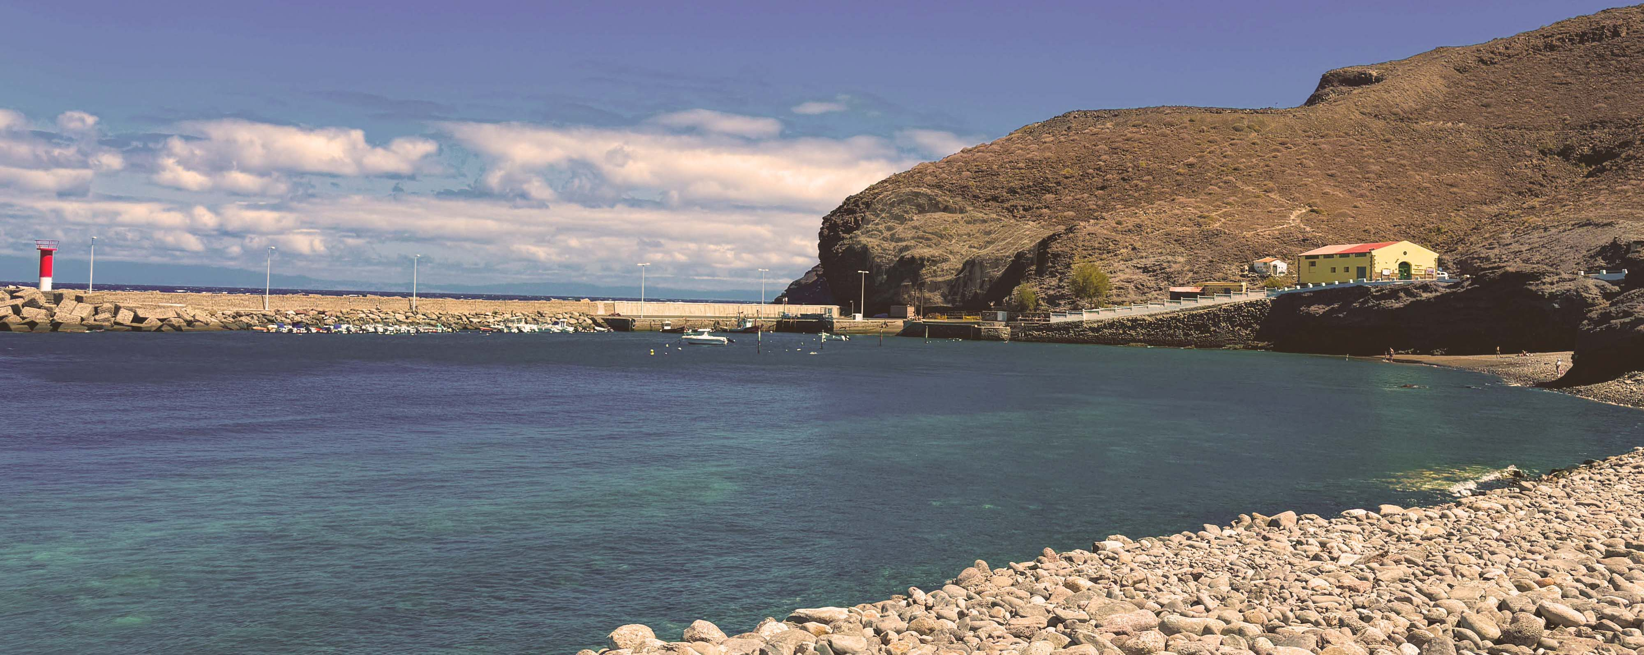
Miami to Morocco & Spain Transatlantic
Miami • Las Palmas de Gran Canaria • Casablanca • Valencia • Barcelona
1 night in Miami + 14 nights sailing
Departing 23 April 2027
All flights included
Insider Lock It In rate from
Sea Terrace Lock It In Rate from £1884pp
£1799pp
£60pp in resort fees payable locally. Subject to change. View terms here: sellvv.co.uk/terms
Insert your
logo here

Slide 3

French Riviera, Spain & Ibiza Overnight
Barcelona • Cannes • Provence (Toulon) • Valencia • Ibiza • Barcelona
1 night in Barcelona + 7 nights sailing
Departing 15 May 2027
All flights included
Sea View Lock It In Rate
Sea Terrace Lock It In Rate from £1752pp
£1649pp
£30pp in resort fees payable locally. Subject to change. View terms here: sellvv.co.uk/terms
Insert your
logo here

Slide 4

Pacific Coastal: LA to Vancouver
Los Angeles • San Diego • San Francisco • Astoria • Victoria • Vancouver
1 night in Los Angeles + 9 nights sailing
Departing 1 May 2027
All flights included
Insider Lock It In rate from
Sea Terrace Lock It In Rate from £2238pp
£1969pp
£60pp in resort fees payable locally. Subject to change. View terms here: sellvv.co.uk/terms
Insert your
logo here

Slide 5
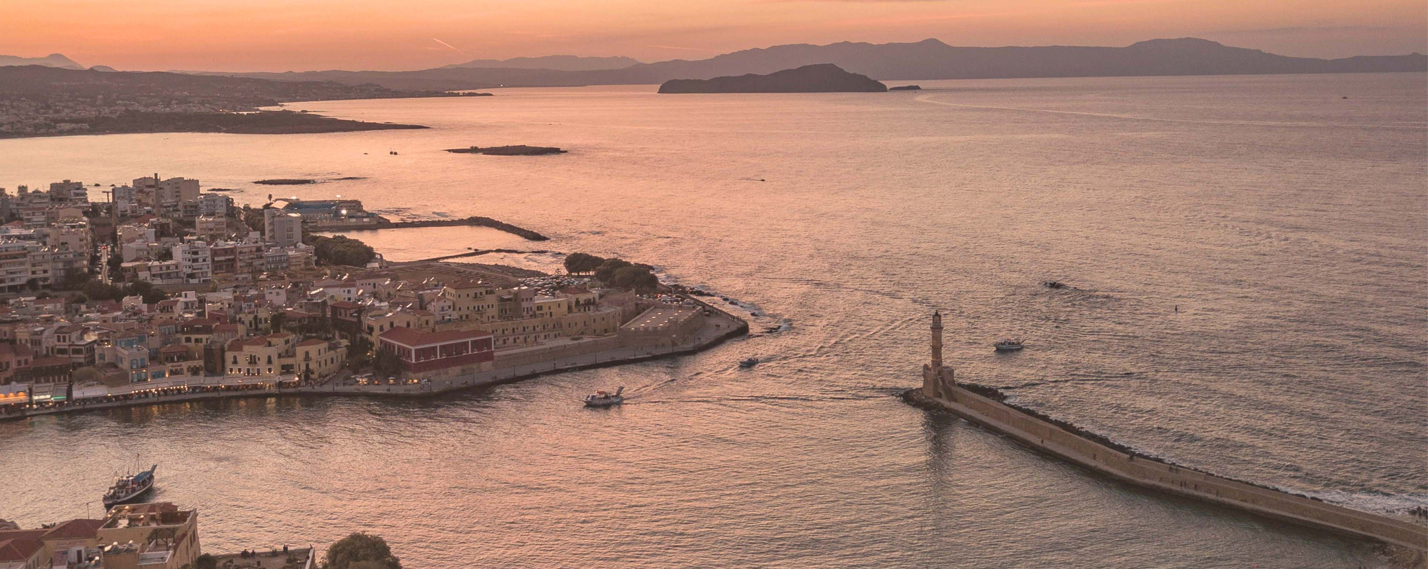
Greek Isles & Mykonos Overnight
Athens (Piraeus) • Chania (Souda Bay) • Bodrum • Santorini • Mykonos • Athens (Piraeus)
1 night in Athens + 7 nights sailing
Departing 18 September 2027
All flights included
Insider Lock It In rate from
Sea Terrace Lock It In Rate from £2277pp
£1909pp
£30pp in resort fees payable locally. Subject to change. View terms here: sellvv.co.uk/terms
Insert your
logo here

Slide 6
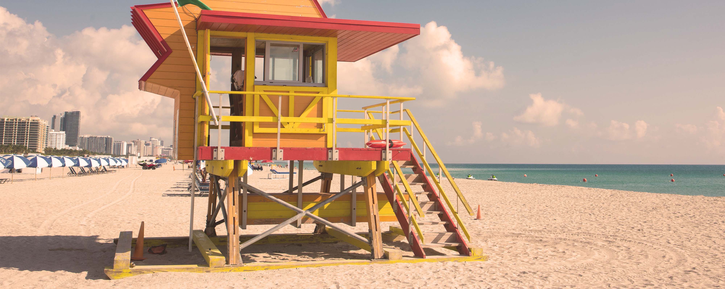
Eastern Caribbean & Bimini Beach Club
Miami • Philipsburg • Tortola • St. Croix • San Juan • Puerto Plata • The Beach Club at Bimini • Miami
1 night in Miami + 10 nights sailing
Departing 7 March 2027
All flights included
Insider Lock It In rate from
Sea Terrace Lock It In Rate from £2187pp
£1889pp
£60pp in resort fees payable locally. Subject to change. View terms here: sellvv.co.uk/terms
Insert your
logo here

