Slide 1
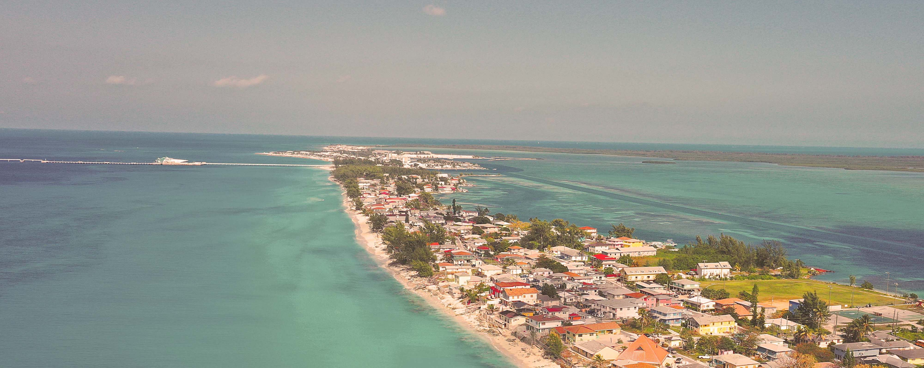




Regional departure pricing available at a supplement:
Manchester £150pp | Dublin £200pp | Edinburgh £200pp
Eastern Caribbean & Bimini Holiday
Miami • San Juan • Charlotte Amalie • Philipsburg • The Beach Club at Bimini • Miami
1 night in Miami + 9 nights sailing
Departing 13 December 2026
All flights included
Lead in package price from
Brilliant Lady
£1239pp
£60pp in resort fees payable locally. Subject to change. View terms here: sellvv.co.uk/terms
Insert your
logo here

Slide 2

Regional departure pricing available at a supplement:
Manchester £150pp | Dublin £200pp | Edinburgh £200pp
Eastern Caribbean & Bimini Beach Club
Miami • Philipsburg • Tortola • Basseterre • St. John's • The Beach Club at Bimini • Miami
1 night in Miami + 10 nights sailing
Departing 21 February 2027
All flights included
Insider Lock It In Rate from
Brilliant Lady
£1879pp*
£60pp in resort fees payable locally. Subject to change. *LIIR: View terms here: sellvv.co.uk/terms
Insert your
logo here

Slide 3
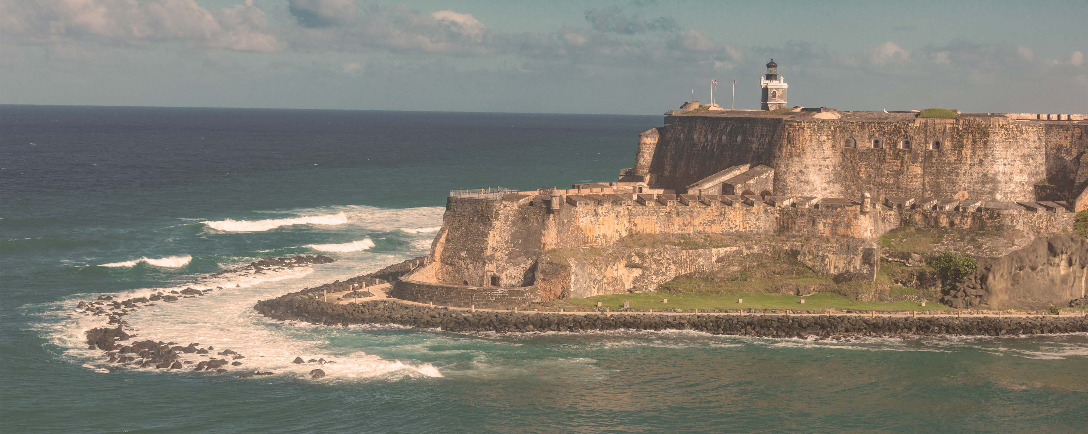
Regional departure pricing available at a supplement:
Manchester £150pp | Dublin £200pp | Edinburgh £200pp
Eastern Caribbean & Bimini Beach Club
Miami • Philipsburg • Tortola • St. Croix • San Juan • Puerto Plata • The Beach Club at Bimini • Miami
1 night in Miami + 10 nights sailing
Departing 7 March 2027
All flights included
Insider Lock It In Rate from
Brilliant Lady
£1888pp*
£60pp in resort fees payable locally. Subject to change. *LIIR: View terms here: sellvv.co.uk/terms
Insert your
logo here

Slide 4

Regional departure pricing available at a supplement:
Manchester £150pp | Dublin £200pp | Edinburgh £200pp
Pacific Coastal: Vancouver to LA
Vancouver • San Francisco • Santa Barbara • San Diego • Catalina Island • Los Angeles
1 night in Vancouver + 8 nights sailing
Departing 9 September 2027
All flights included
Lead in package price from
Brilliant Lady
£2199pp
£60pp in resort fees payable locally. Subject to change. View terms here: sellvv.co.uk/terms
Insert your
logo here

Slide 5
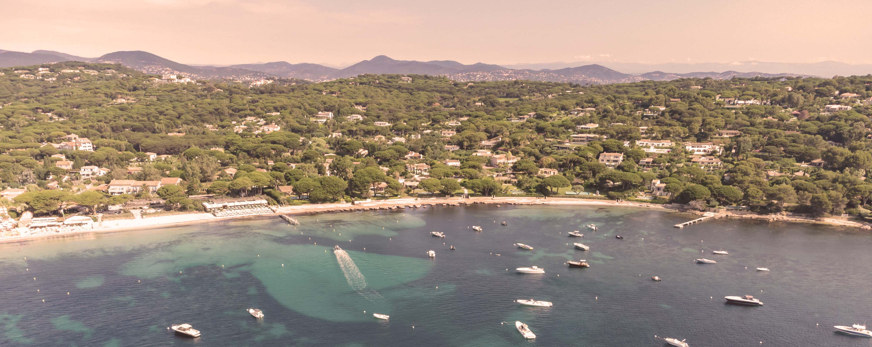
Regional departure pricing available at a supplement:
Manchester £150pp | Dublin £200pp | Edinburgh £200pp
French Riviera, Spain & Ibiza Overnight
Barcelona • Nice (Villefranche) • Provence (Toulon) • Valencia • Ibiza • Barcelona
1 night in Barcelona + 7 nights sailing
Departing 26 June 2027
All flights included
Lead in package price from
Resilient Lady
£1669pp
£30pp in resort fees payable locally. Subject to change. View terms here: sellvv.co.uk/terms
Insert your
logo here

Slide 6

Regional departure pricing available at a supplement:
Manchester £150pp | Dublin £200pp | Edinburgh £200pp
Red Hot Sailing Club Voyage
from Athens
Athens (Piraeus) • Santorini • Chania (Souda Bay) • Ephesus (Kuşadasi) • Mykonos • Athens (Piraeus)
1 night in Athens + 7 nights sailing
Departing 3 July 2027
All flights included
Sea View Lock It In Rate from
Scarlet Lady
£1747pp*
£30pp in resort fees payable locally. Subject to change. *LIIR: View terms here: sellvv.co.uk/terms
Insert your
logo here

