Slide 1
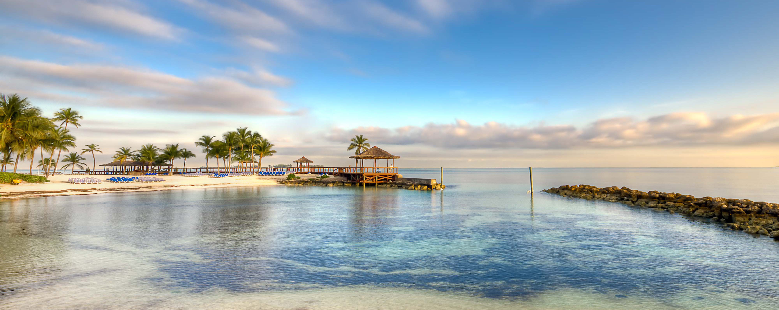




Regional departure pricing available at a supplement:
Manchester £150pp | Dublin £200pp | Edinburgh £200pp
Western Caribbean & Bimini Beach Club
Miami • George Town • Ocho Rios • Nassau • The Beach Club at Bimini • Miami
1 night in Miami + 7 nights sailing
Departing 6 February 2027
All flights included
Insider Lock It In Rate from
Resilient Lady
£1649pp*
£60pp in resort fees payable locally. Subject to change. *LIIR: View terms here: sellvv.co.uk/terms
Insert your
logo here

Slide 2

Regional departure pricing available at a supplement:
Manchester £150pp | Dublin £200pp | Edinburgh £200pp
Italy, French Riviera & Spain
Barcelona • Tuscany/Cinque Terre (La Spezia) • Rome (Civitavecchia) •
Ajaccio • Provence (Marseille) • Palma de Mallorca • Barcelona
1 night in Barcelona + 7 nights sailing
Departing 3 July 2027
All flights included
Insider Lock It In Rate from
Resilient Lady
£1609pp*
£30pp in resort fees payable locally. Subject to change. *LIIR: View terms here: sellvv.co.uk/terms
Insert your
logo here

Slide 3
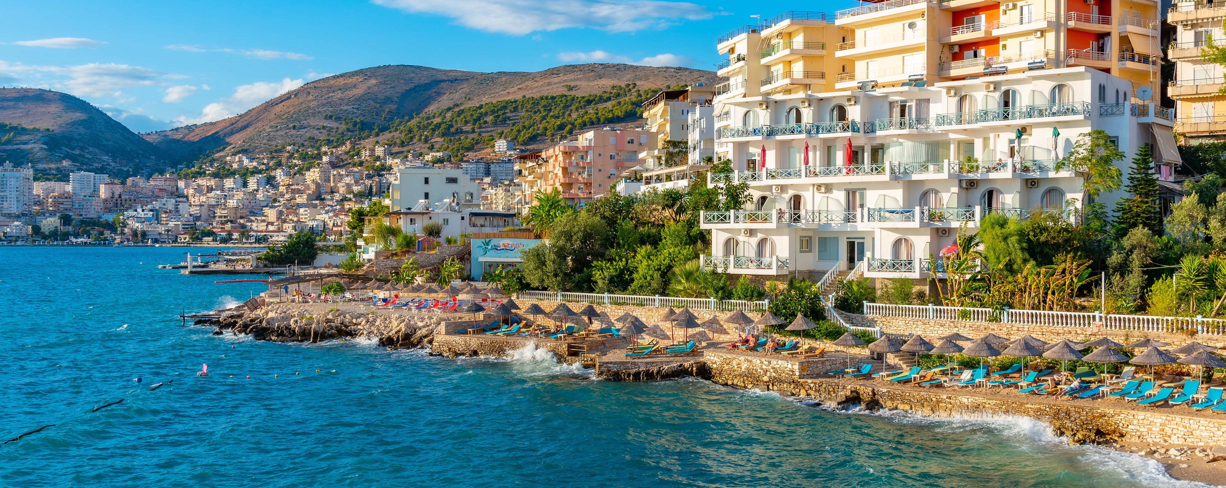
Regional departure pricing available at a supplement:
Manchester £150pp | Dublin £200pp | Edinburgh £200pp
The Adriatic, Albania & Greece
Athens (Piraeus) • Dubrovnik • Kotor • Sarandë • Mykonos • Athens (Piraeus)
1 night in Athens + 7 nights sailing
Departing 14 August 2027
All flights included
Insider Lock It In Rate from
Scarlet Lady
£1759pp*
£30pp in resort fees payable locally. Subject to change. *LIIR: View terms here: sellvv.co.uk/terms
Insert your
logo here

Slide 4

Regional departure pricing available at a supplement:
Manchester £150pp | Dublin £200pp | Edinburgh £200pp
Greek Isles & Mykonos Overnight
Athens (Piraeus) • Santorini • Rhodes • Bodrum • Mykonos • Athens (Piraeus)
1 night in Athens + 7 nights sailing
Departing 7 August 2027
All flights included
Insider Lock It In Rate from
Scarlet Lady
£1769pp*
£30pp in resort fees payable locally. Subject to change. *LIIR: View terms here: sellvv.co.uk/terms
Insert your
logo here

Slide 5
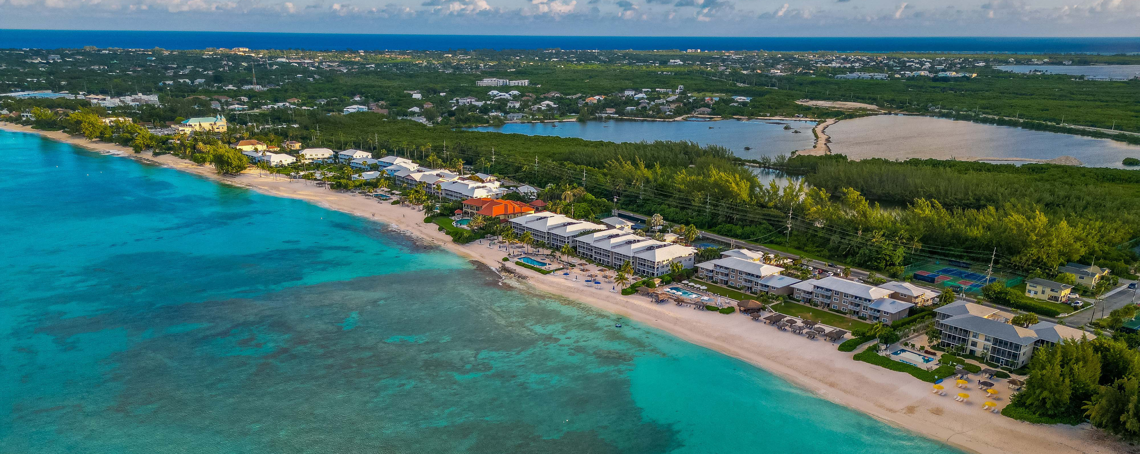
Regional departure pricing available at a supplement:
Manchester £150pp | Dublin £200pp | Edinburgh £200pp
Western Caribbean & Bimini Beach Club
Miami • Ocho Rios • George Town • The Beach Club at Bimini • Miami
1 night in Miami + 6 nights sailing
Departing 9 January 2027
All flights included
Insider Lock It In Rate from
Resilient Lady
£1649pp*
£60pp in resort fees payable locally. Subject to change. *LIIR: View terms here: sellvv.co.uk/terms
Insert your
logo here

Slide 6

Regional departure pricing available at a supplement:
Manchester £150pp | Dublin £200pp | Edinburgh £200pp
Eastern Caribbean & Bimini Beach Club
Miami • Philipsburg • Tortola • St. Croix • San Juan • Puerto Plata • The Beach Club at Bimini • Miami
1 night in Miami + 10 nights sailing
Departing 10 January 2027
All flights included
Lead in package price from
Brilliant Lady
£1979pp
£60pp in resort fees payable locally. Subject to change. View terms here: sellvv.co.uk/terms
Insert your
logo here

