Slide 1





Eastern Caribbean & Bimini Beach Club
Miami • Philipsburg • Tortola • St. Croix • San Juan • Puerto Plata • The Beach Club at Bimini • Miami
1 night in Miami + 10 nights sailing
Departing 29 November 2026
All flights included
Lead in package price from
Sea Terrace cabin from £2219pp
Offer reference 131532
£2039pp
£60pp in resort fees payable locally. Subject to change. View terms here: sellvv.co.uk/terms
Insert your
logo here

Slide 2
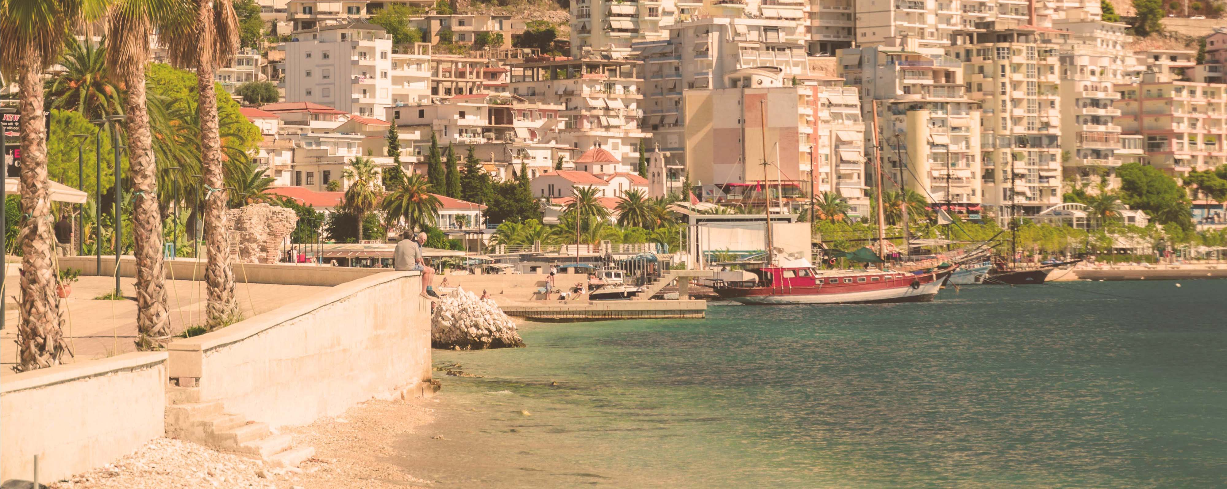
The Adriatic, Albania & Greece
Athens (Piraeus) • Dubrovnik • Kotor • Sarandë • Mykonos • Athens (Piraeus)
1 night in Athens + 7 nights sailing
Departing 19 June 2027
All flights included
Lead in package price from
Sea Terrace cabin from £2529pp
Offer reference 131573
£2149pp
£30pp in resort fees payable locally. Subject to change. View terms here: sellvv.co.uk/terms
Insert your
logo here

Slide 3

Europe: Barcelona to Portsmouth
Barcelona • Tangier • Lisbon • La Coruña • Bilbao • Bordeaux (Le Verdon) • Portsmouth
1 night in Barcelona + 10 nights sailing
Departing 25 July 2026
Flight included
Lead in package price from
Offer reference 131320
£1499pp
£30pp in resort fees payable locally. Subject to change. View terms here: sellvv.co.uk/terms
Insert your
logo here

Slide 4

Greek Isles & Mykonos Overnight
Athens (Piraeus) • Bodrum • Rhodes • Mykonos • Santorini • Athens (Piraeus)
1 night in Athens + 7 nights sailing
Departing 26 September 2026
All flights included
Lead in package price from
Sea Terrace cabin from £1949pp
£1749pp
£30pp in resort fees payable locally. Subject to change. View terms here: sellvv.co.uk/terms
Insert your
logo here

Slide 5

Solar Eclipse: Barcelona to Rome
Barcelona • Palma de Mallorca • Ibiza • Cannes • Ajaccio • Tuscany/Cinque Terre (La Spezia) •
Amalfi Coast (Salerno) • Catania • Rome (Civitavecchia)
1 night in Barcelona + 12 nights sailing
Departing 9 August 2026
All flights included
Lead in package price from
Sea Terrace cabin from £2549pp
£2249pp
£30pp in resort fees payable locally. Subject to change. View terms here: sellvv.co.uk/terms
Insert your
logo here

Slide 6

Italy, Spain & French Riviera
Barcelona • Palma de Mallorca • Provence (Marseille) • Cannes • Ajaccio •
Tuscany/Cinque Terre (La Spezia) • Barcelona
1 night in Barcelona + 8 nights sailing
Departing 1 August 2026
All flights included
Lead in package price from
Sea Terrace cabin from £2149pp
£1749pp
£30pp in resort fees payable locally. Subject to change. View terms here: sellvv.co.uk/terms
Insert your
logo here

