Slide 1
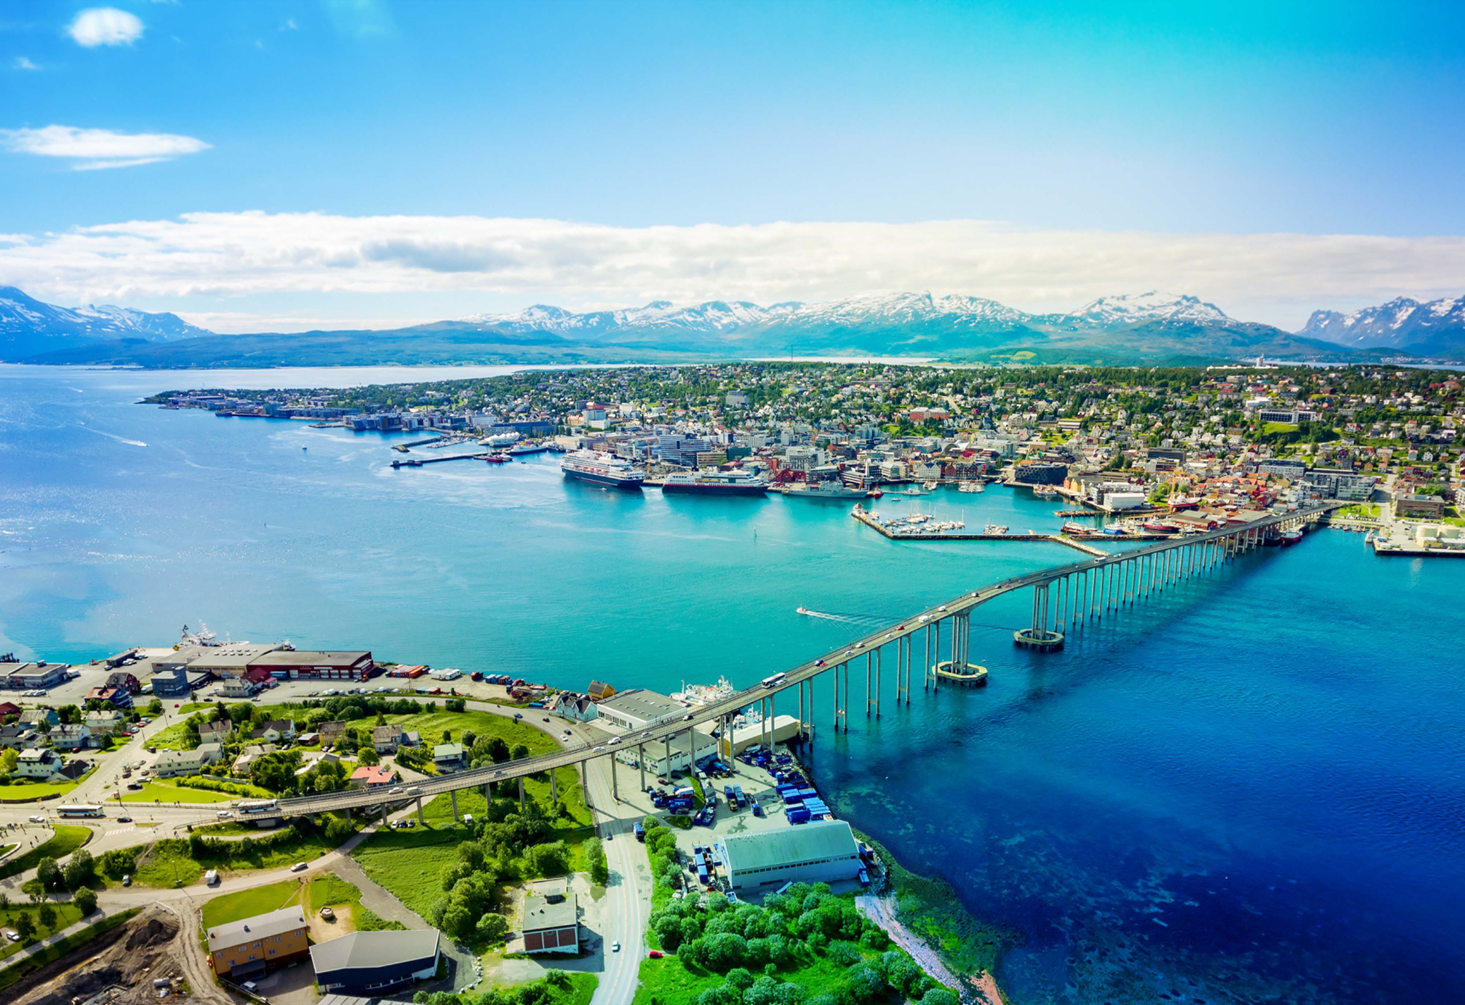



Arctic Circle & Norwegian Fjords
Amsterdam • Bergen • Arctic Circle (Cruising) • Tromsø • Honningsvåg •
Arctic Circle (Cruising) • Trondheim • Åndalsnes • Olden • Amsterdam
1 night in Amsterdam
+ 11 nights sailing
Departing 13 August 2028
All flights included
Lead in package price from
Sea Terrace cabin from £2907pp
£2521pp
£30pp in resort fees payable locally. Subject to change. View terms here: sellvv.co.uk/terms
Insert your
logo here

Slide 2

Western Europe: Barcelona to Amsterdam
Barcelona • Casablanca • Lisbon (Overnight) • La Coruna • Cherbourg • Amsterdam
1 night in Barcelona
+ 10 nights sailing
Departing 8 July 2028
All flights included
Lead in package price from
Sea Terrace cabin from £2503pp
£2153pp
£30pp in resort fees payable locally. Subject to change. View terms here: sellvv.co.uk/terms
Insert your
logo here

Slide 3
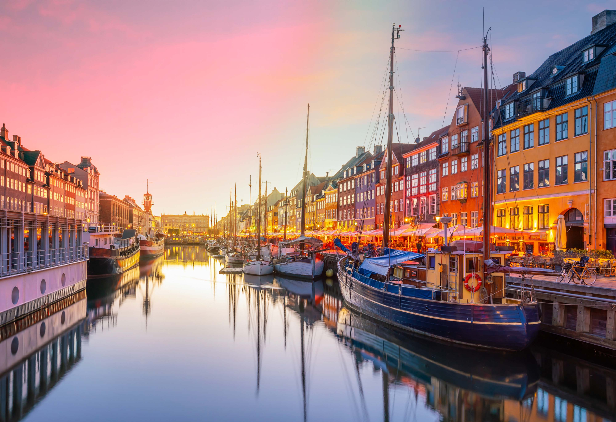
Scandinavia & Stockholm Overnight
Amsterdam • Oslo • Copenhagen • Gdańsk (Gdynia) •
Stockholm • Berlin (Warnemünde) • Aarhus • Amsterdam
1 night in Amsterdam
+ 12 nights sailing
Departing 18 July 2028
All flights included
Lead in package price from
Sea Terrace cabin from £2749pp
£2328pp
£30pp in resort fees payable locally. Subject to change. View terms here: sellvv.co.uk/terms
Insert your
logo here

Slide 4

Scandinavia & Hamburg
Amsterdam • Oslo • Copenhagen • Hamburg • Amsterdam
1 night in Amsterdam
+ 7 nights sailing
Departing 6 August 2028
All flights included
Lead in package price from
Sea Terrace cabin from £2070pp
£1825pp
£30pp in resort fees payable locally. Subject to change. View terms here: sellvv.co.uk/terms
Insert your
logo here

Slide 5
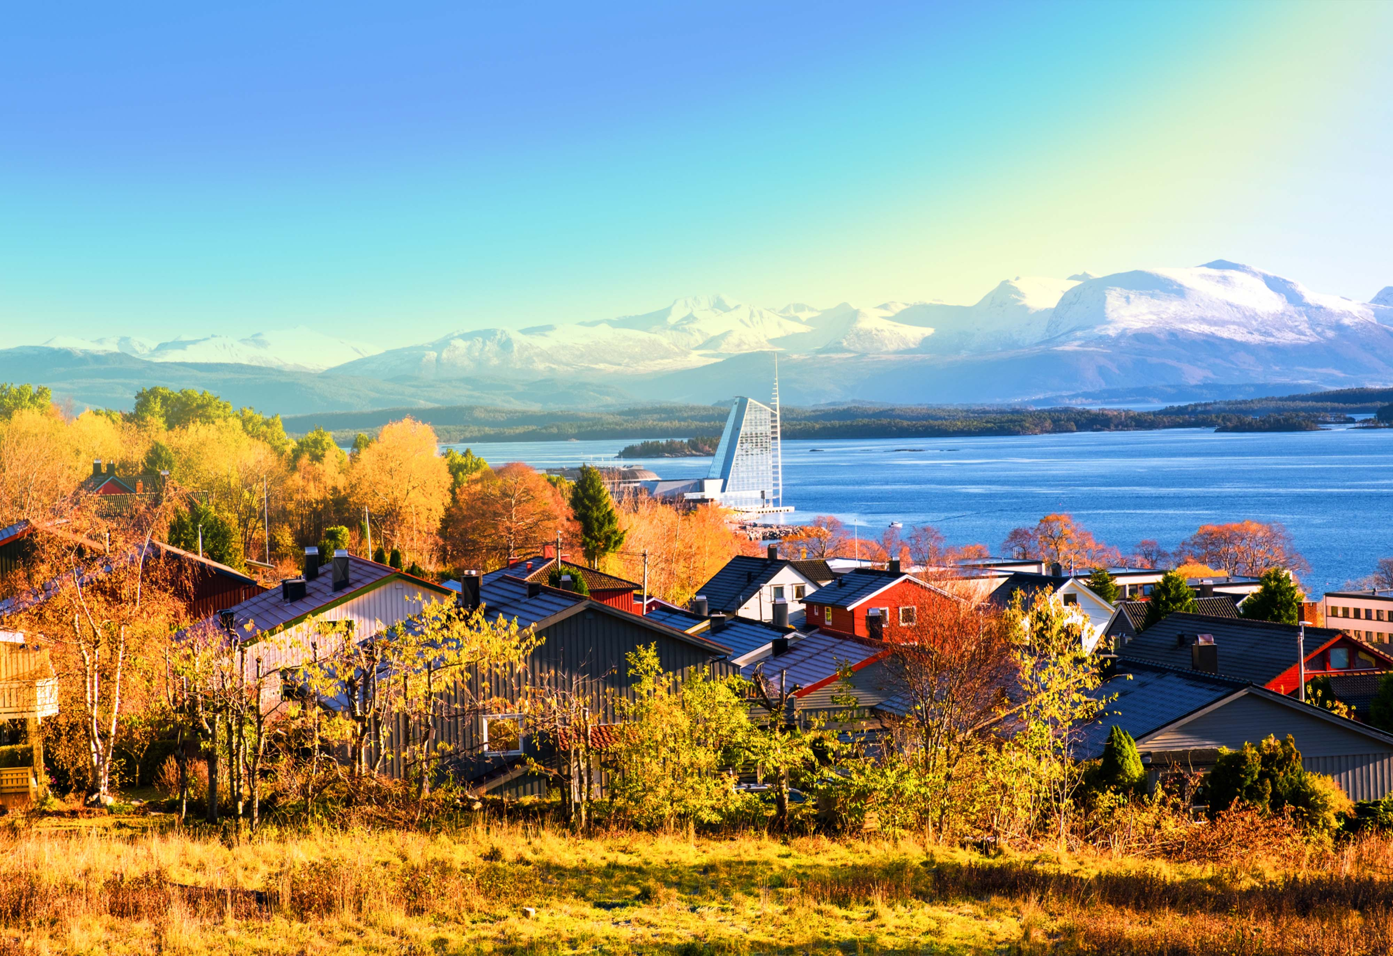
Norwegian Fjords
Amsterdam • Molde • Nordfjordeid • Flåm • Bergen • Amsterdam
1 night in Amsterdam
+ 7 nights sailing
Departing 30 July 2028
All flights included
Lead in package price from
Sea Terrace cabin from £2162pp
£1917pp
£30pp in resort fees payable locally. Subject to change. View terms here: sellvv.co.uk/terms
Insert your
logo here

