Slide 1





Italy, French Riviera & Spain
Barcelona • Nice (Villefranche) • Rome (Civitavecchia) •
Amalfi Coast (Salerno) • Catania • Palma de Mallorca • Barcelona
1 night in Barcelona + 7 nights sailing
Departing 22 May 2027
All flights included
Lead in package price from
Sea Terrace cabin from £1969pp
Offer reference 130990
£1779pp
£30pp in resort fees payable locally. Subject to change. View terms here: sellvv.co.uk/terms
Insert your
logo here

Slide 2

Solar Eclipse: Spain, Italy & France
Barcelona • Palma de Mallorca • Ibiza • Cannes • Ajaccio • Tuscany/Cinque Terre (La Spezia) •
Amalfi Coast (Salerno) • Catania • Rome (Civitavecchia)
1 night in Barcelona + 12 nights sailing
Departing 9 August 2026
All flights included
Lead in package price from
Sea Terrace cabin from £2599pp
FREE BALCONY UPGRADE
£2299pp
£30pp in resort fees payable locally. Subject to change. View terms here: sellvv.co.uk/terms
Insert your
logo here

Slide 3

Greek Island Glow
Athens (Piraeus) • Santorini • Rhodes • Bodrum • Mykonos • Athens (Piraeus)
1 night in Athens + 7 nights sailing
Departing 26 September 2026
All flights included
Lead in package price from
Sea Terrace cabin from £2099pp
FREE BALCONY UPGRADE
£1799pp
£30pp in resort fees payable locally. Subject to change. View terms here: sellvv.co.uk/terms
Insert your
logo here

Slide 4

Mexican Riviera Cruise
Los Angeles • Cabo San Lucas • Mazatlán • Puerto Vallarta • Los Angeles
1 night in Los Angeles + 7 nights sailing
Departing 25 September 2026
All flights included
Lead in package price from
Sea Terrace cabin from £1889pp
Offer reference 130997
£1719pp
£60pp in resort fees payable locally. Subject to change. View terms here: sellvv.co.uk/terms
Insert your
logo here

Slide 5
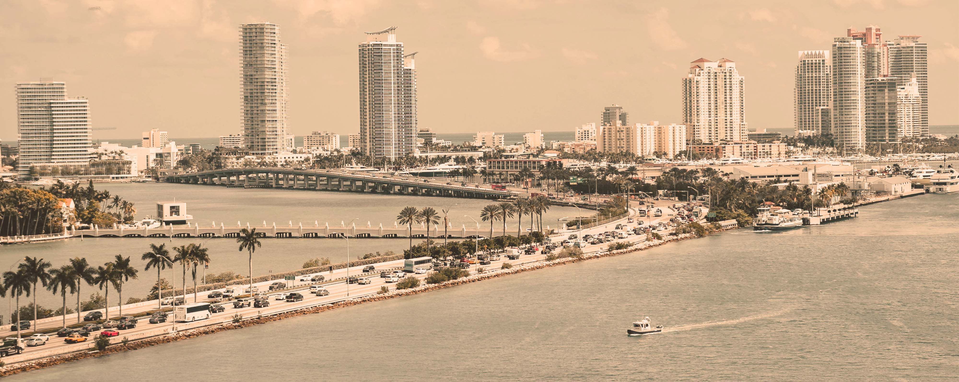
Sisters at Sea: Scarlet Lady
Miami • Freeport • The Beach Club at Bimini • Miami
1 night in Miami + 5 nights sailing
Departing 14 February 2027
All flights included
Lead in package price from
Sea Terrace cabin from £2159pp
Offer reference 131000
£2039pp
£60pp in resort fees payable locally. Subject to change. View terms here: sellvv.co.uk/terms
Insert your
logo here

Slide 6

Dominican Republic & Bimini Beach Club
Miami • Puerto Plata • The Beach Club at Bimini • Miami
1 night in Miami + 5 nights sailing
Departing 10 December 2027
All flights included
Lead in package price from
Sea Terrace cabin from £2269pp
Offer reference 130992
£1989pp
£60pp in resort fees payable locally. Subject to change. View terms here: sellvv.co.uk/terms
Insert your
logo here

