Slide 1






French Riviera, Italy & Ibiza Overnight
Barcelona • Nice (Villefranche) • Rome (Civitavecchia) • Ajaccio • Ibiza • Barcelona
6 nights + 1 night in Barcelona
Departing 27 June 2026
Return flights included
LEAD IN PRICE FROM
Sea Terrace cabin from £1309pp
Offer reference 128111
£1099pp
£30pp in resort fees payable locally. Subject to change. View terms here: sellvv.co.uk/terms
Insert your
logo here

Slide 2

Greek Island Glow
Athens (Piraeus) • Santorini • Rhodes • Bodrum • Mykonos • Athens (Piraeus)
7 nights + 1 night in Athens
Departing 30 May 2026
Return flights included
LEAD IN PRICE FROM
Sea Terrace cabin from £1319pp
Offer reference 128108
£1119pp
£30pp in resort fees payable locally. Subject to change. View terms here: sellvv.co.uk/terms
Insert your
logo here

Slide 3

Greek Isles & Istanbul Overnight
Athens (Piraeus) • Istanbul • Ephesus (Kuşadasi) • Mykonos • Chania (Souda Bay) •
Rhodes • Santorini • Athens (Piraeus)
11 nights + 1 night in Athens
Departing 23 June 2026
Return flights included
LEAD IN PRICE FROM
Sea Terrace cabin from £1739pp
Offer reference 128109
£1329pp
£30pp in resort fees payable locally. Subject to change. View terms here: sellvv.co.uk/terms
Insert your
logo here

Slide 4

Eastern Caribbean & Bimini Beach Club
Miami • Philipsburg • Tortola • Basseterre • St. John's • The Beach Club at Bimini • Miami
10 nights + 1 night in Miami
Departing 14 November 2026
Return flights included
LEAD IN PRICE FROM
Sea Terrace cabin from £2069pp
Offer reference 128119
£1669pp
£60pp in resort fees payable locally. Subject to change. View terms here: sellvv.co.uk/terms
Insert your
logo here

Slide 5

Mexican Riviera Cruise
Los Angeles • Cabo San Lucas • Mazatlán • Puerto Vallarta • Los Angeles
7 nights + 1 night in Los Angeles
Departing 2 October 2026
Return flights included
LEAD IN PRICE FROM
Sea Terrace cabin from £1679pp
Offer reference 128116
£1379pp
£60pp in resort fees payable locally. Subject to change. View terms here: sellvv.co.uk/terms
Insert your
logo here

Slide 6
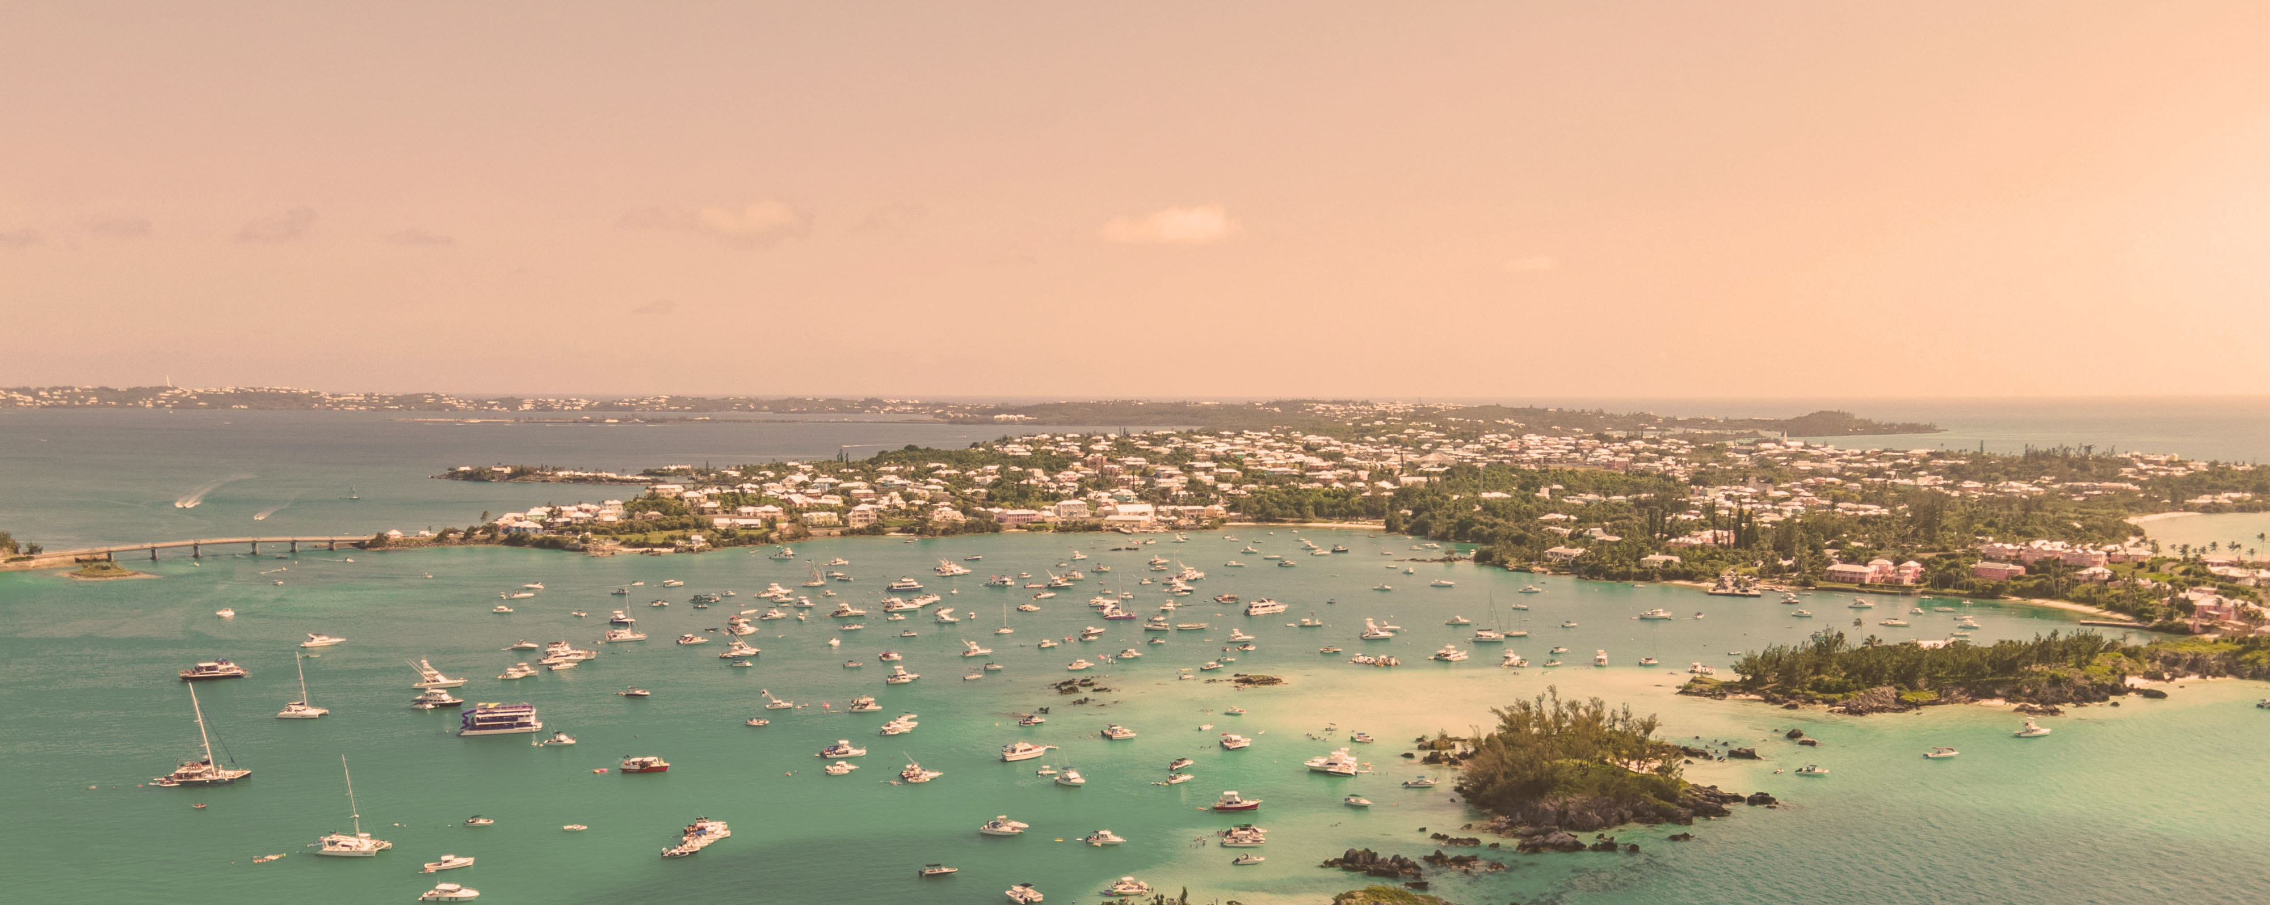
New York to Bermuda (& Back)
New York City • Royal Naval Dockyard • New York City
6 nights + 1 night in New York
Departing 12 October 2026
Return flights included
LEAD IN PRICE FROM
Sea Terrace cabin from £1699pp
Offer reference 128115
£1399pp
£60pp in resort fees payable locally. Subject to change. View terms here: sellvv.co.uk/terms
Insert your
logo here

