Slide 1
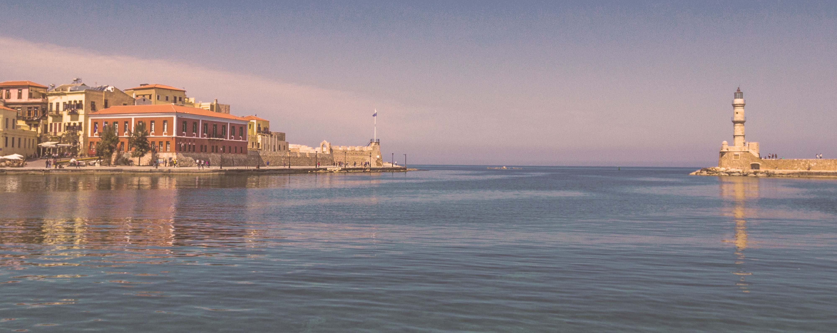




Red Hot Sailing Club Voyage from Athens
Athens (Piraeus) • Santorini • Chania (Souda Bay) • Ephesus (Kuşadasi) • Mykonos • Athens (Piraeus)
1 night in Athens + 7 nights sailing
Departing 3 July 2027
All flights included
Lead in package price from
Sea Terrace cabin from £2409pp
Offer reference 129877
£2159pp
£30pp in resort fees payable locally. Subject to change. View terms here: sellvv.co.uk/terms
Insert your
logo here

Slide 2

Virgin Voyages Comedy Fest from the UK
Portsmouth • Bruges/Zeebrugge (Brussels) • Amsterdam • Hamburg • Portsmouth
7 nights sailing
Departing 20 August 2026
Lead in price from
Sea Terrace cabin from £1295pp
£1052pp
View terms here: sellvv.co.uk/terms
Insert your
logo here

Slide 3
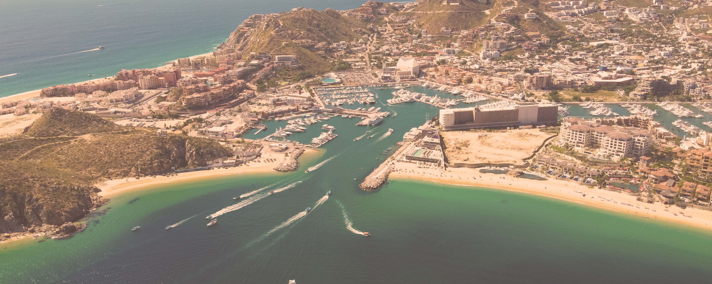
Panama Canal: Miami to Los Angeles
Miami • Cartagena • Colón • Panama Canal (Cruising) • Puntarenas •
Puerto Quetzal • Cabo San Lucas • Los Angeles
1 night in Miami + 16 nights sailing
Departing 20 February 2028
All flights included
Lead in package price from
Sea Terrace cabin from £3929pp
Offer reference 130414
£3109pp
£60pp in resort fees payable locally. Subject to change. View terms here: sellvv.co.uk/terms
Insert your
logo here

Slide 4

French Riviera, Italy & Ibiza Overnight
Barcelona • Rome (Civitavecchia) • Florence/Pisa (Livorno) • Cannes • Ibiza • Barcelona
1 night in Barcelona + 7 nights sailing
Departing 3 July 2026
All flights included
Lead in package price from
Sea Terrace cabin from £1549pp
FREE BALCONY UPGRADE
£1249pp
£30pp in resort fees payable locally. Subject to change. View terms here: sellvv.co.uk/terms
Insert your
logo here

Slide 5

Mediterranean: Rome to Athens
Rome (Civitavecchia) • Florence/Pisa (Livorno) • Salerno (Amalfi Coast) • Catania •
Chania (Souda Bay) • Santorini • Mykonos • Athens (Piraeus)
2 nights in Rome + 10 nights sailing
Departing 29 August 2026
All flights included
Lead in package price from
Sea Terrace cabin from £3499pp
FREE BALCONY UPGRADE
£2699pp
£30pp in resort fees payable locally. Subject to change. View terms here: sellvv.co.uk/terms
Insert your
logo here

Slide 6

French Riviera, Italy, Rome, Amalfi & Sicily
Barcelona • Provence (Marseille) • Nice (Villefranche) • Rome (Civitavecchia) •
Amalfi Coast (Salerno) • Catania • Palermo • Barcelona
1 night in Barcelona + 8 nights sailing
Departing 10 July 2026
All flights included
Lead in package price from
Sea Terrace cabin from £2199pp
FREE BALCONY UPGRADE
£1649pp
£30pp in resort fees payable locally. Subject to change. View terms here: sellvv.co.uk/terms
Insert your
logo here

