Slide 1
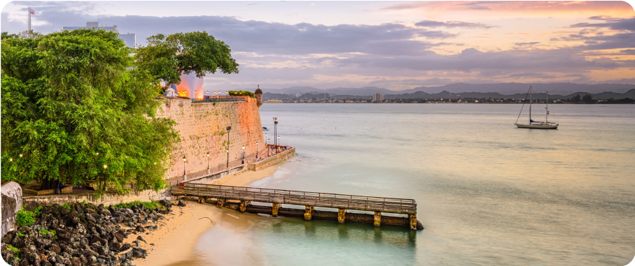





Eastern Caribbean &
Bimini Beach Club
Miami • Puerto Plata • San Juan • St. Croix • The Beach Club at Bimini • Miami
8 nights + 1 night in Miami
26 March 2027
Return flights from the UK
LEAD IN PACKAGE
PRICE FROM
Sea Terrace cabin from £4,229pp
Offer reference: 126021
£3759pp
CMA compliant. View terms here: sellvv.co.uk/terms
£60pp in resort fees payable locally. Subject to change.
Insert your
logo here

Slide 2
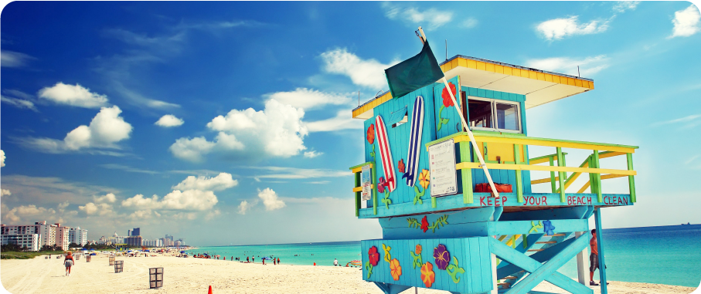
Dominican Republic &
Bimini New Years
Miami • Puerto Plata • The Beach Club at Bimini • Miami
5 nights + 2 nights in Miami
28 December 2026
Return flights from the UK
LEAD IN PACKAGE
PRICE FROM
Sea Terrace cabin from £2,969pp
Offer reference: 125428
£2679pp
CMA compliant. View terms here: sellvv.co.uk/terms
£60pp in resort fees payable locally. Subject to change.
Insert your
logo here

Slide 3
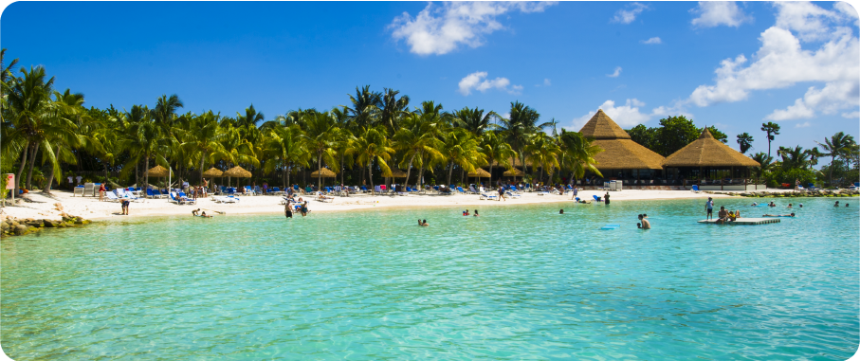
Southern Caribbean &
Aruban Nights
San Juan • Oranjestad • Willemstad • Fort-de-France • Basseterre & San Juan
7 nights + 2 nights in San Juan
7 January 2027
Return flights from the UK
LEAD IN PACKAGE
PRICE FROM
Sea Terrace cabin from £2,924pp
Offer reference: 126612
£2729pp
CMA compliant. View terms here: sellvv.co.uk/terms
£60pp in resort fees payable locally. Subject to change.
Insert your
logo here

Slide 4



Coastal Gems:
Italy, France & Spain
Barcelona • Toulon • Marina di Carrara • Ajaccio, Corsica • Ibiza • Barcelona
7 nights + 1 night in Barcelona
6 June 2026
Return flights from the UK
SEA TERRACE PACKAGE
PRICE FROM
$400 Bar Tab included
£1699pp
CMA compliant. View terms here: sellvv.co.uk/terms
£30pp in resort fees payable locally. Subject to change.
Insert your
logo here

Slide 5

Spanish Serenity to
French Daydreams
Barcelona • Palma de Mallorca • Valencia • Cannes • Ibiza • Barcelona
7 nights + 1 night in Barcelona
13 June 2026
Return flights from the UK
SEA TERRACE PACKAGE
PRICE FROM
$400 Bar Tab included
£1699pp
CMA compliant. View terms here: sellvv.co.uk/terms
£30pp in resort fees payable locally. Subject to change.
Insert your
logo here

Slide 6

Greek Isles and
Mykonos Overnight
Athens (Piraeus) • Santorini • Rhodes • Bodrum • Mykonos • Athens (Piraeus)
7 nights + 1 night in Athens
30 May 2026
Return flights from the UK
SEA TERRACE PACKAGE
PRICE FROM
$400 Bar Tab included
£1849pp
CMA compliant. View terms here: sellvv.co.uk/terms
£30pp in resort fees payable locally. Subject to change.
Insert your
logo here

