Slide 1
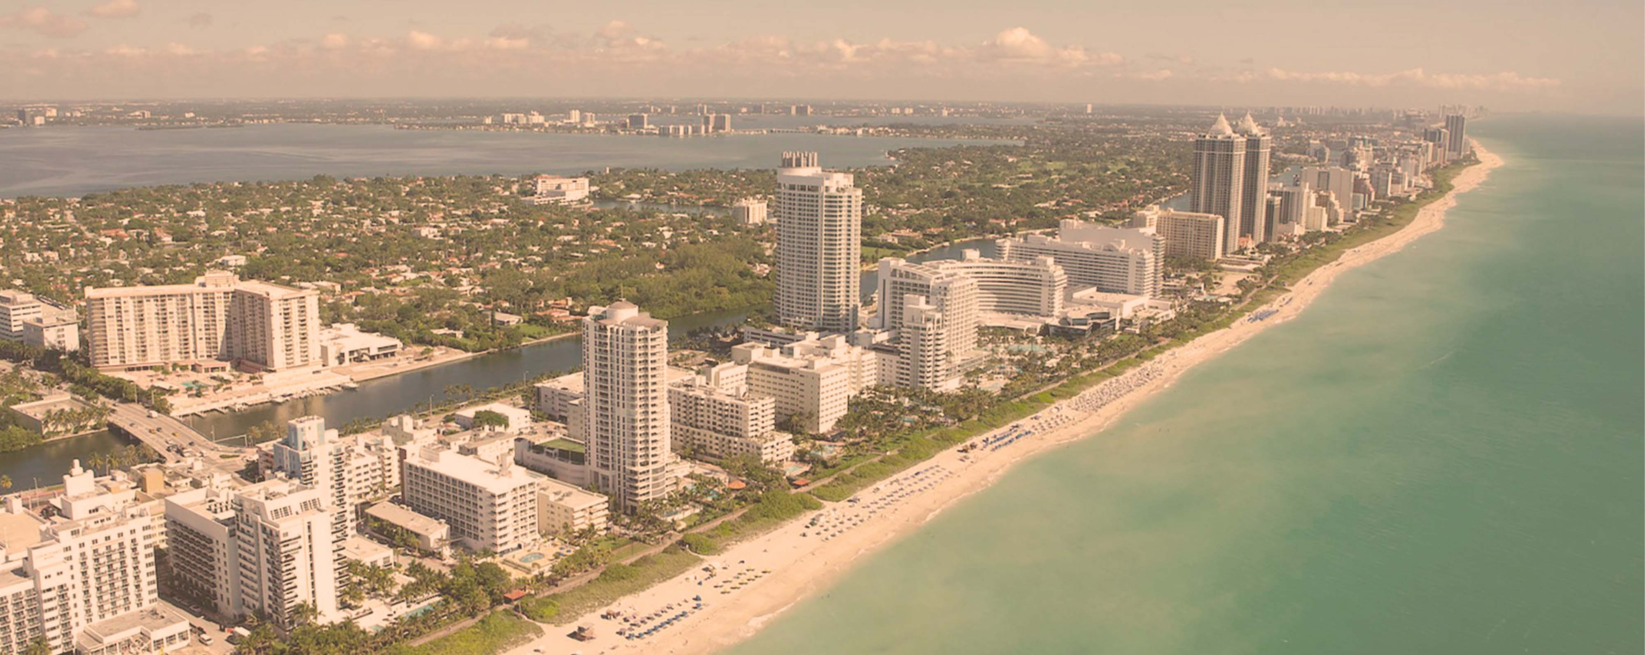




Sisters at Sea: Brilliant Lady
Miami • Philipsburg • Tortola • St. Croix • San Juan • Puerto Plata • The Beach Club at Bimini • Miami
1 night in Miami + 10 nights
Departing 7 February 2027
All flights included
Lead in package price from
Sea Terrace cabin from £2949pp
Offer reference 129136
£2489pp
£60pp in resort fees payable locally. Subject to change. View terms here: sellvv.co.uk/terms
Insert your
logo here

Slide 2
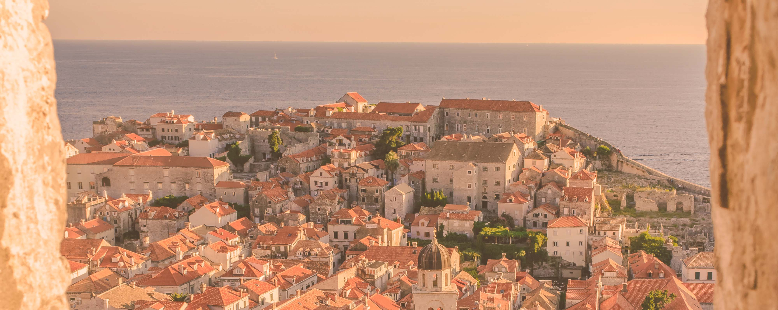
Croatia, Montenegro, Greece & Albania
Athens (Piraeus) • Dubrovnik • Kotor • Sarandë • Mykonos • Athens (Piraeus)
Departing 25 September 2027
All flights included
1 night in Athens + 7 nights
Lead in package price from
Sea Terrace cabin from £2179pp
Offer reference 129860
£1899pp
£30pp in resort fees payable locally. Subject to change. View terms here: sellvv.co.uk/terms
Insert your
logo here

Slide 3

Red Hot Sailing Club Voyage from Athens
Athens (Piraeus) • Santorini • Chania (Souda Bay) • Ephesus • Mykonos • Athens (Piraeus)
1 night in Athens + 7 nights
Departing 3 July 2027
All flights included
Lead in package price from
Sea Terrace cabin from £2149pp
Offer reference 129877
£1899pp
£30pp in resort fees payable locally. Subject to change. View terms here: sellvv.co.uk/terms
Insert your
logo here

Slide 4

French Riviera, Italy & Ibiza Overnight
Barcelona • Rome (Civitavecchia) • Florence/Pisa (Livorno) • Cannes • Ibiza • Barcelona
1 night in Barcelona + 7 nights
Departing 3 July 2026
All flights included
Lead in package price from
Sea Terrace cabin from £1549pp
FREE BALCONY UPGRADE
£1249pp
£30pp in resort fees payable locally. Subject to change. View terms here: sellvv.co.uk/terms
Insert your
logo here

Slide 5

Italy, Spain & French Riviera
Barcelona • Palma de Mallorca • Provence (Marseille) • Cannes •
Ajaccio • Tuscany/Cinque Terre (La Spezia) • Barcelona
1 night in Barcelona + 8 nights
Departing 1 August 2026
All flights included
Lead in package price from
Sea Terrace cabin from £2149pp
FREE BALCONY UPGRADE
£1749pp
£30pp in resort fees payable locally. Subject to change. View terms here: sellvv.co.uk/terms
Insert your
logo here

Slide 6

Alaska: Inside Passage & Glacial Fjords
Seattle • Inside Passage (Cruising Alaska) • Ketchikan • Sitka •
Endicott Arm & Dawes Glacier (Cruising) • Prince Rupert • Seattle
2 nights in Seattle + 7 nights
Departing 14 July 2026
All flights included
Lead in package price from
Sea Terrace cabin from £2859pp
Offer reference 129888
£2479pp
£60pp in resort fees payable locally. Subject to change. View terms here: sellvv.co.uk/terms
Insert your
logo here

